Slide 1
Web Application & E-Commerce
INTRODUCTION TO INFORMATION TECHNOLOGY
Nafisatul Hasanah, S.Kom., M.M.
FAKULTAS ILMU KOMPUTER
PROGRAM SARJANA TEKNOLOGI INFORMASI

Slide 2
Capaian Pembelajaran
Web Application vs Website
E-Business and E-Commerce
E-Commerce vs Marketplace

Slide 3

Web Application

Slide 4
Web Application
What is a Website?
A website is a group of globally accessible, interlinked web pages which have a single domain name.
The website aims to serve a variety of purposes. Example: Blogs.

Slide 5
Web Application
What is a Web Application?
A web application is a software or program which is accessible using any web browser. Its frontend is usually created using languages like HTML, CSS, Javascript, which are supported by major browsers.

Slide 6
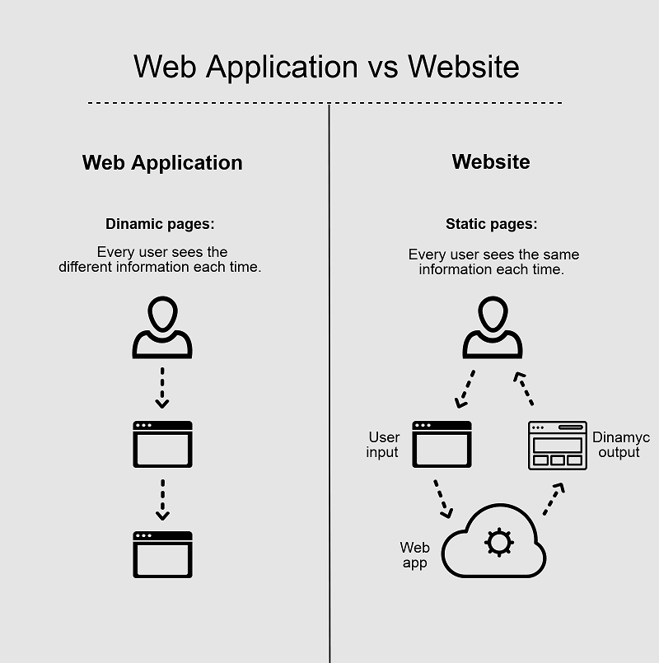
Web Application

Slide 7
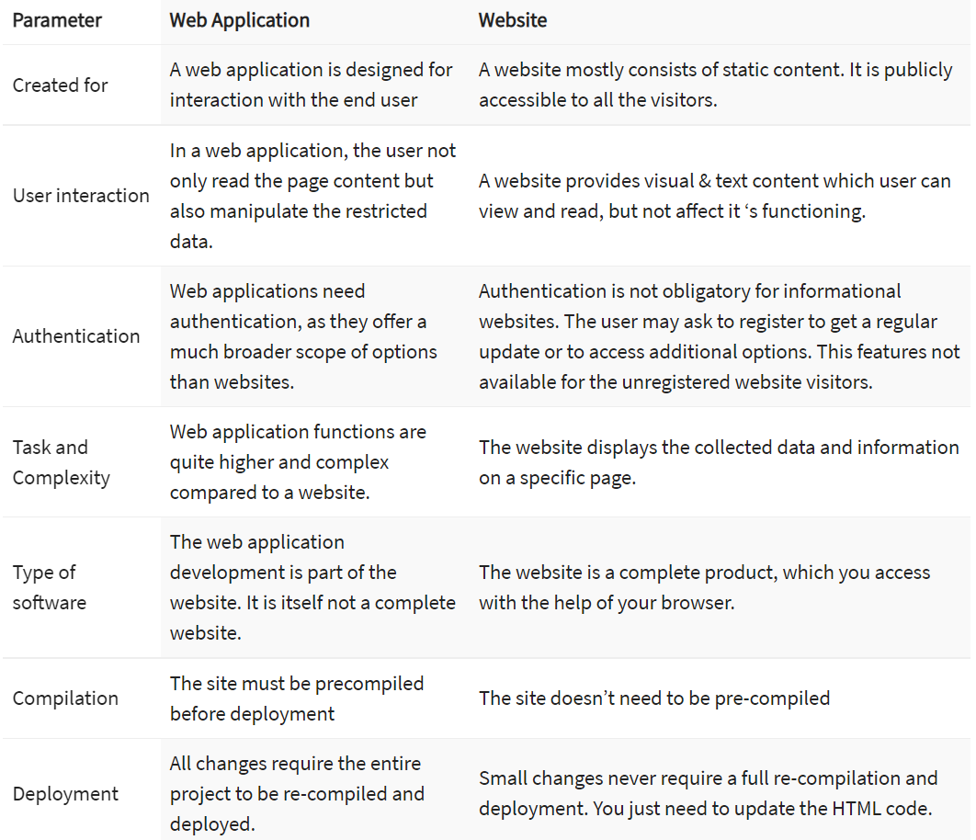
Characteristics

Slide 8
Summary
A website is a group of globally accessible, interlinked web pages which have a single domain name.
A web application is a software or program which is accessible using any web browser.
Developing your website helps you in branding your business.
App store approval not required in web applications
Quality and relevant Web Content are the most important characteristics of a good web site.
Cloud-hosted and highly scalable are the most vital characteristics of a good web application.

Slide 9
Types of Web Application Frameworks
Client-Side Web Frameworks
Front-end web development holds three technologies as core to its very being — JavaScript, CSS, and HTML.
Server-Side Web Frameworks
Server-side frameworks provide tools and libraries for managing back-end structures.

Slide 10
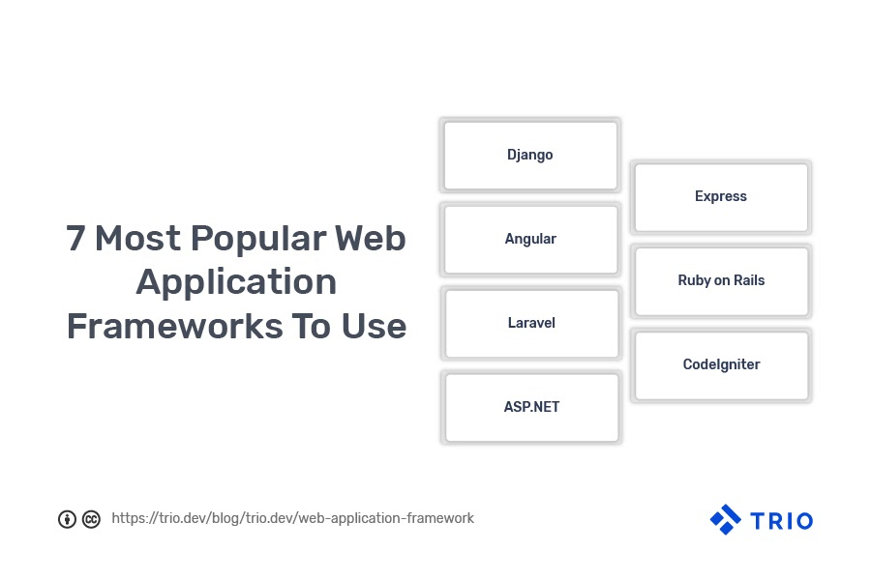
Web Application Framework

Slide 11
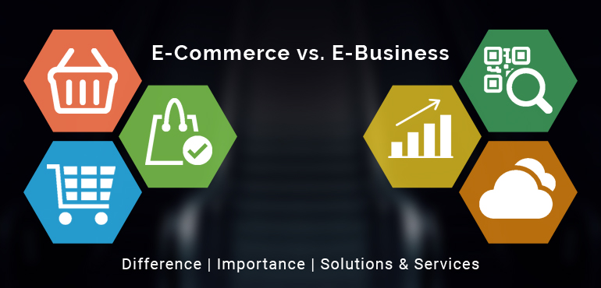
Pendahuluan

Slide 12
E-Business
E-business (electronic business) is the conduct of business processes on the internet.
These e-business processes include buying and selling goods and services, servicing customers, processing payments, managing production control, collaborating with business partners, sharing information, running automated employee services, recruiting; and more.

Slide 13
e-Business

Slide 14
Internal Business Application
Digunakan untuk mendukung kegiatan, proses, dan operasi bisnis yang bersifat internal bagi perusahaan
Contoh:
Pemrosesan transaksi internal
Enterprise information portal
Sistem pendukung manajemen

Slide 15
E-Commerce
Ecommerce, or electronic commerce, refers to transactions conducted via the internet. Every time individuals and companies are buying or selling products and services online they’re engaging in ecommerce.

Slide 16
Advantage of E-Commerce
Produk dan layanan bervariasi
Mempersingkat rantai distribusi
Pembayaran lebih mudah
Brand lebih dekat dengan konsumen
Peningkatan kualitas layanan
Belanja kapan saja
Efisiensi biaya

Slide 17
Disavantage E-Commerce
Ketergantungan yang sangat kuat pada teknologi informasi dan komunikasi
Kurangnya undang-undang yang memadai untuk mengatur kegiatan e-commerce, baik nasional maupun internasional
Budaya pasar yang menolak perdagangan elektronik (pelanggan tidak bisa menyentuh atau mencoba produk)
“Hilangnya” privasi, cakupan wilayah, serta identitas dan perekonomian negara
Rawannya melakukan transaksi bisnis online
Warna dan kualitas produk yang dijual belum tentu sama antara foto yang ditampilkan di website dengan produk asli

Slide 18
E-Commerce
Business-to-Business (B2B)
In the B2B ecommerce model both parties involved are businesses. In this type of a transaction, one business provides the other with products and/or services.

Slide 19
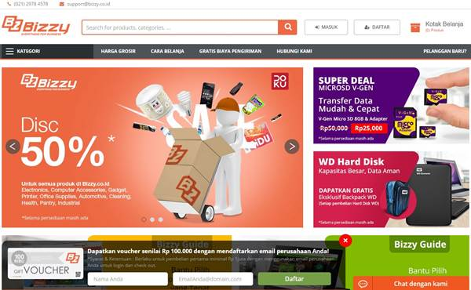
Business-to-Business (B2B)
Contoh website e-commerce B2B adalah Bizzy dan Ralali.
Produk yang disediakan oleh Bizzy antara lain, Office Supplies (ATK), Elektronik, Pantry dan lain-lain.

Slide 20
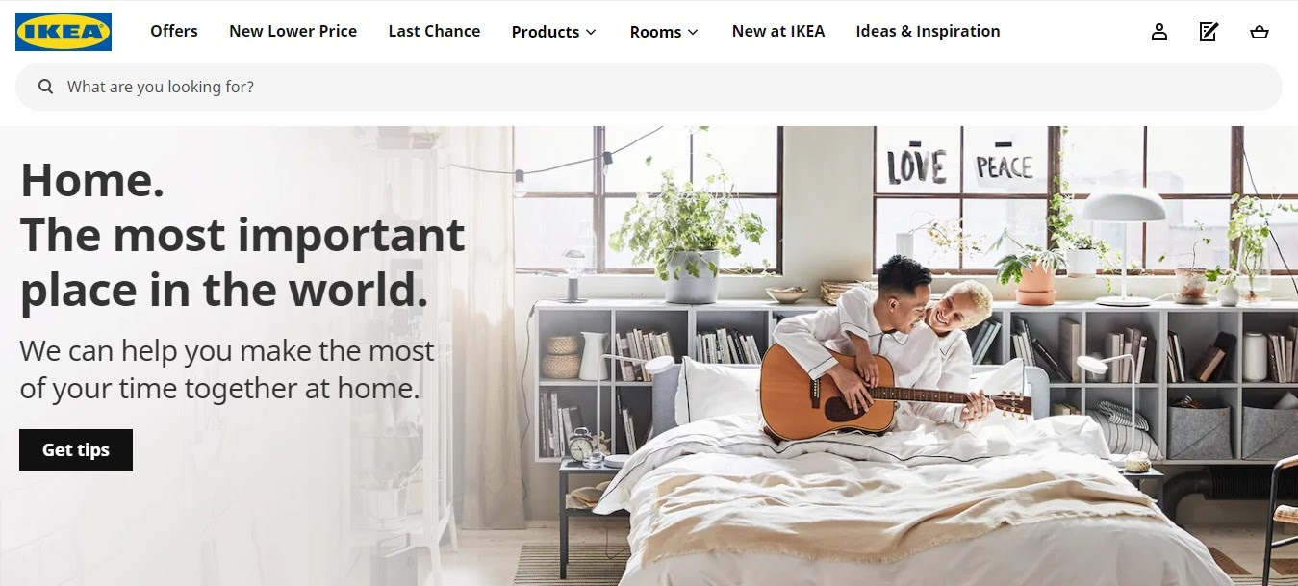
E-Commerce
Business-to-Consumer (B2C)
As the name suggests, the B2C ecommerce model represents a transaction between businesses and individuals. B2C ecommerce is the most common business model among both physical and online retailers.

Slide 21
E-Commerce
Consumer-to-Consumer (C2C)
C2C ecommerce happens when the two parties involved are consumers that trade with one another. eBay and Craigslist are examples of online marketplaces where individuals buy and sell products to each other.

Slide 22
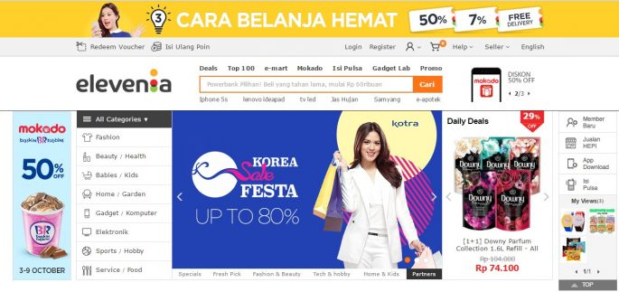
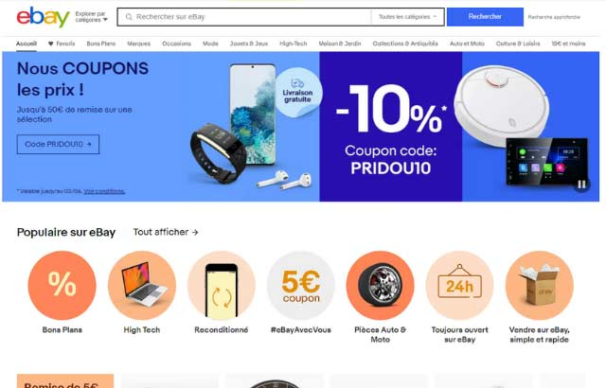
Consumer-to-Consumer (C2C)

Slide 23
E-Commerce
Consumer-to-Business (C2B)
The C2B business model represents a transaction in which individuals create value for businesses, unlike the traditional business-to-consumer model where companies are the ones that deliver value.
Consumers provide companies with products and/or services, co-operate on projects, and ultimately help businesses increase their profits.

Slide 24
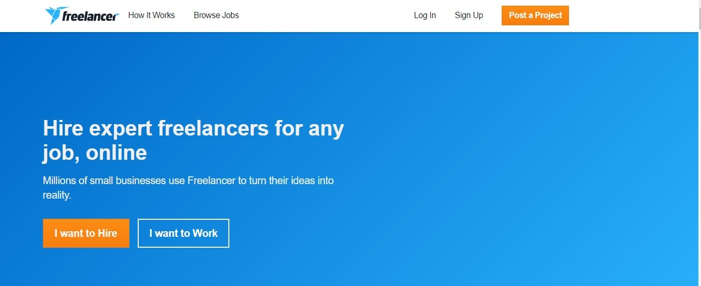
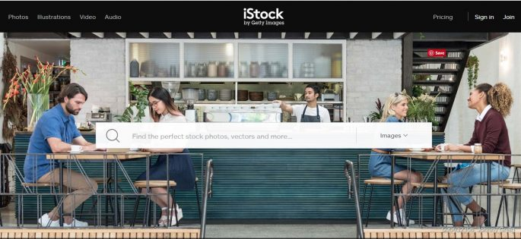
Consumer-to-Business (C2B)

Slide 25
E-Commerce
Business-to-Administration (B2A)
Beberapa contoh website administrasi publik yang menerapkan B2A adalah www.pajak.go.id, www.allianz.com dan www.bpjs-online.com. Disana perusahaan dapat melakukan proses transaksi atas jasa yang mereka dapatkan langsung kepada pihak administrasi publik.

Slide 26
E-Commerce
Online-to-Offline (O2O)
O2O adalah jenis e-commerce yang menarik pelanggan dari saluran online untuk toko fisik.
Beberapa perusahaan besar dengan pertumbuhan yang cepat seperti Uber dan Airbnb juga menjalankan bisnis mereka dengan jenis O2O.

Slide 27
E-Commerce
B2G ( Business to Government )
The B2G model refers to companies and businesses that provide goods and services for the government.
For example, OpenGov is a company that offers governments cloud-based platforms for communication, reporting, and budgeting.

Slide 28
E-Commerce
Consumer to government (C2G)
Every time consumers pay taxes, health insurance, electronic bills, or request information concerning the public sector, they’re engaging in C2G.

Slide 29
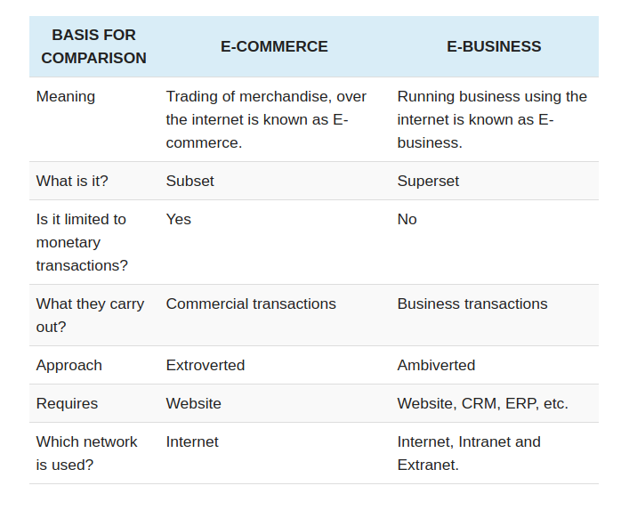
E-Business VS E-Commerce

Slide 30
Top E-Commerce
Alibaba: Launching in 1999, The Chinese company Alibaba is by far the world’s most successful e-commerce company and retailer, hosting the largest B2B (Alibaba.com), C2C (Taobao.com), and B2C (Tmall) marketplaces across the globe.
Amazon: Amazon is the largest e-commerce retailer in the United States, and has changed the face of retail so much that a burning question for most retailers is how to beat Amazon.
Walmart: Once the top retailer in the US, Walmart has focused mightily upon their online business, with great results, offering traditional retail sales, as well as grocery delivery and subscription services.
eBay: One of the first e-commerce sites, eBay still dominates the digital market space, allowing for businesses and individuals to sell their products online.

Slide 31
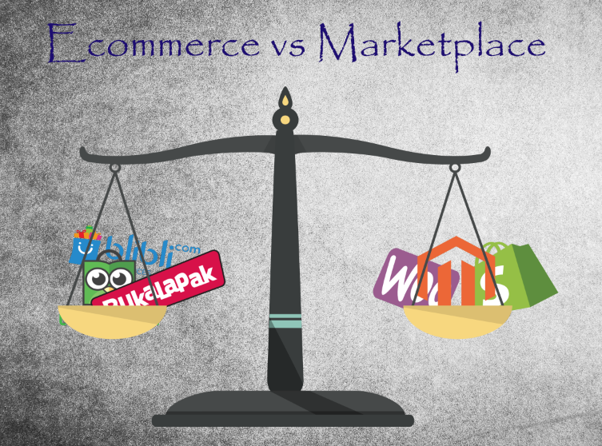
E-Commerce vs Marketplace

Slide 32
References

